Slide 1
Folding SMS into Military Aerospace Programs
A Little Merge Work

Slide 2
Folding SMS into Military Aerospace Programs
Agenda
Introduction
Background
The Guts of the Presentation

Slide 3
Folding SMS into Military Aerospace Programs
Quick Acronyms & References
ASI Air Safety Investigator
ASO Aviation Safety Official
The contractor individual assigned primary responsibility for developing and administering the contractor’s aviation safety program.
DCMA Defense Contract Management Agency
8210.1 DCMA Instruction – “Contractor’s Flight and Ground Operations” (8210.1C, 21 August 2013, used)

Slide 4
Folding SMS into Military Aerospace Programs
Introduction – The Players
So, who did the work?
  Primary contributors
    John Karstens and Alex “Sid” Sidlowski
      Both at the Patuxent River Naval Air Station, Maryland, at the time
      Aviation safety for defense, commercial and commercial derivative programs
  And we work for
    The Boeing Company
      Engineering, Test & Technology
      Mission – Innovate, test and deliver solutions that create a competitive advantage for Boeing and its customers
        - Made up of Boeing Research & Technology and Boeing Test & Evaluation
        Boeing Test & Evaluation (BT&E)
        Mission – Validate that products and services meet the highest Boeing standards of safety, quality and reliability

Slide 5
Folding SMS into Military Aerospace Programs
Background – “Why the Effort?”
Mandates
  ICAO Annex 19
  Safety Management (applicable – November 2013)
  FAA Advisory Circular (AC) 120-92B (January 8, 2015)
  Safety Management Systems for Aviation Service Providers
    Applicable to 14 CFR part 121 air carriers
  BT&E Program Directive 2500004D0000 (June 7, 2013)
  BT&E Safety Management System Implementation
    Handwriting on the wall for OEM, so get out ahead of the game

Slide 6
Folding SMS into Military Aerospace Programs
Background – “Why the Effort?”
US Military Documents
  ARMY REGULATION 385–10
  27 NOVEMBER 2013
  THE ARMY SAFETY PROGRAM
SUMMARY OF CHANGES
This major revision --
o Introduces Army Safety Management System (paras 2-3 and 2-7).
  OPNAVINST 3750.6S
  13 MAY 2014
  NAVAL AVIATION SAFETY MANAGEMENT SYSTEM
1. Purpose. To issue policies and provisions of the Naval Aviation Safety Management System (SMS). The format, scope and content of this revision differ significantly from the superseded instruction. Changes include compliance with reference (a), the establishment of the SMS, removal of message traffic format and the data collection appendices, which were replaced with data collection in the on-line environment, and clarification of mishap exception rules. This instruction is a complete revision and should be reviewed in its entirety.

Slide 7
Folding SMS into Military Aerospace Programs
Background – “Why the Effort?”
US Military Documents (continued)
  AIR FORCE INSTRUCTION 91-202
  24 JUNE 2015
  THE US AIR FORCE MISHAP PREVENTION PROGRAM
SUMMARY OF CHANGES
This document is substantially revised and must be completely reviewed. This revision establishes the Air Force Safety Management System (AFSMS) as the framework for the mishap prevention program. Chapter 1, Program Overview, introduces and provides the interface of the AFSMS within the mishap prevention program. Chapter 3, Safety Assurance, has been rewritten to ensure cohesion of the Air Force Inspection System and the required safety oversight process as it relates to Air Force safety assurance. Attachment 17, Annual AFSMS Review Plan, has been added identifying the annual review requirements for the AFSMS.
  AP8000
  March 2016
  Royal Air Force Safety Management Plan
  1. Purpose. The Safety Management System (SMS) model adopted by the RAF meets the Defence Safety Authority (DSA) requirement that all Defence aviation organizations establish a SMS that is consistent with the requirements laid down in MAA Regulatory Article (RA) 1200 and incorporates wider Health & Safety and Environmental Protection requirements articulated within JSP815. The RAF Safety Management Plan (SMP) describes the organization, processes and procedures by which the RAF manages all aspects of Safety.

Slide 8
Folding SMS into Military Aerospace Programs
Background – “Why the Effort?”
  Why SMS . . . ?
  Contributions to a safer enterprise
    Emphasizes safety management as a fundamental business process to be considered in the same manner as other aspects of business management
    Implement a framework and integrate methodologies to more effectively manage safety
    Commonality across BT&E, the enterprise, and customers (including military)
The safety of the aviation industry is of critical importance both in terms of accident / incident prevention and the financial performance of the industry. The development of Safety Management Systems (SMS) and their endorsement by the International Civil Aviation Organisation (ICAO) facilitates a more coordinated approach of the various elements that create a safe operation.
Cranfield University SMS in Aviation Web Site

Slide 9
Folding SMS into Military Aerospace Programs
Background – “Why the Effort?”
  . . . and why Pax River?
  Demonstrate value sooner – realize opportunity to accelerate implementation
    Take advantage of mature, highly-compliant flight test programs to create SMS-compliant / replicable model
    PAX programs more in line with ICAO/FAA SMS requirements through compliance with USG Ground/Flight Risk Clause (DCMAI 8210.1)
Without a firm understanding of the procedures necessary at the lowest levels,
an organization cannot create an effective, efficient process flow for all levels

Slide 10
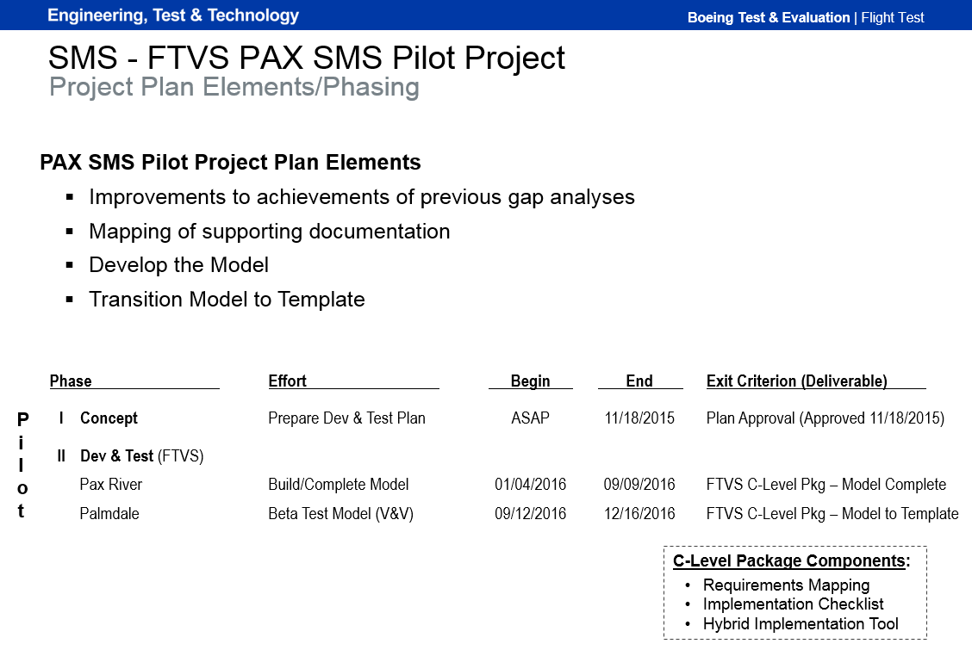
Folding SMS into Military Aerospace Programs
Background -
4x
Straight-forward
2-Phase Execution
Exit Criteria

Slide 11
Folding SMS into Military Aerospace Programs
Element 1 – Improvements to . . . gap analyses
  Two previous gap analyses
  Provided a general path forward within scope of each
    Preliminary gap analysis – ___ questions
    Detailed gap analysis – 75 questions
  Still left a “gap” to comprehensive SMS implementation

Slide 12
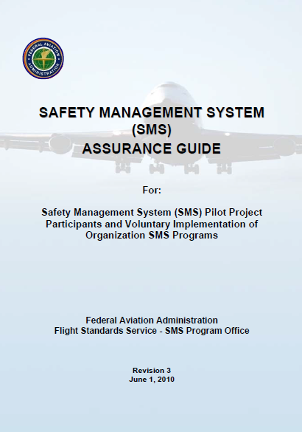
Folding SMS into Military Aerospace Programs
Element 2 – Mapping . . . documentation

Slide 13
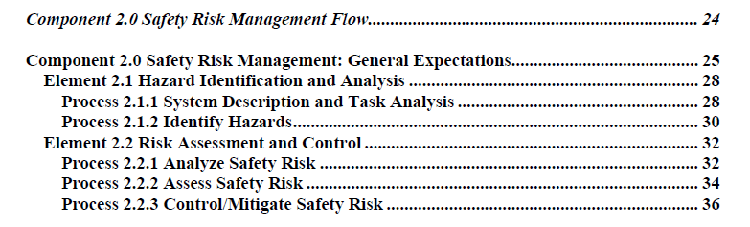
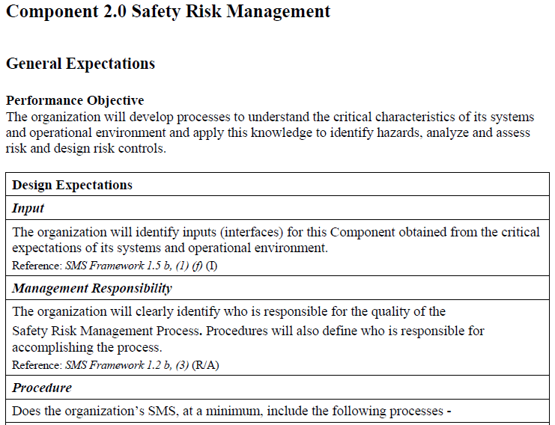
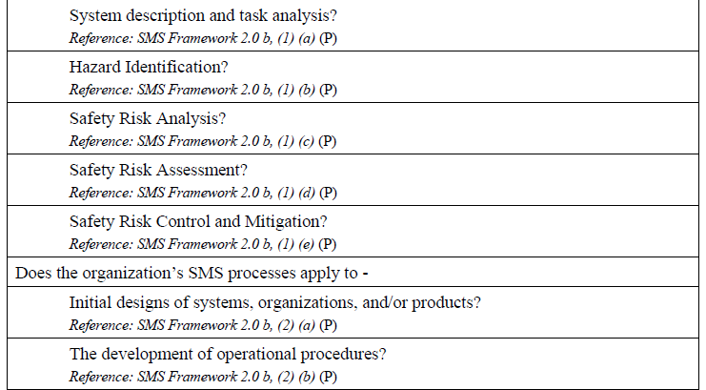
Folding SMS into Military Aerospace Programs
Element 2 – Mapping . . . documentation

Slide 14
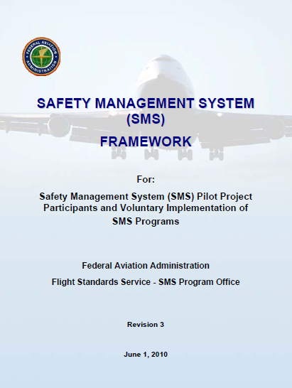
Folding SMS into Military Aerospace Programs
Element 2 – Mapping . . . documentation

Slide 15
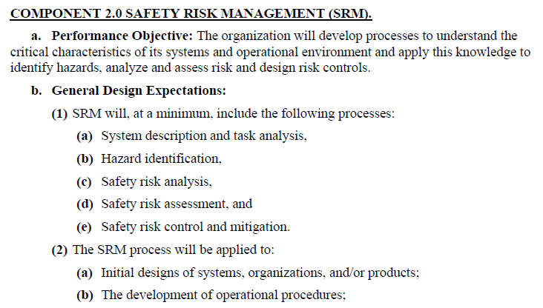
Folding SMS into Military Aerospace Programs
Element 2 – Mapping . . . documentation

Slide 16
Folding SMS into Military Aerospace Programs
Element 2 – Mapping . . . documentation
Developing our organizational model
  Both a detailed gap analysis and the FAA SMS Assurance Guide indicated that compliance required effort at different levels of the organization.
  Being ex-US Air Force flightcrew, Sid and I fell back on an organizational concept (for modeling our effort) that made sense to us:
AF Structure:
Major Command
Numbered Air Force
Wing
BT&E Equivalent:
BT&E
Flight Test / Lab Test
Capability / Site / Program
Level:
“A”
“B”
“C”

Slide 17
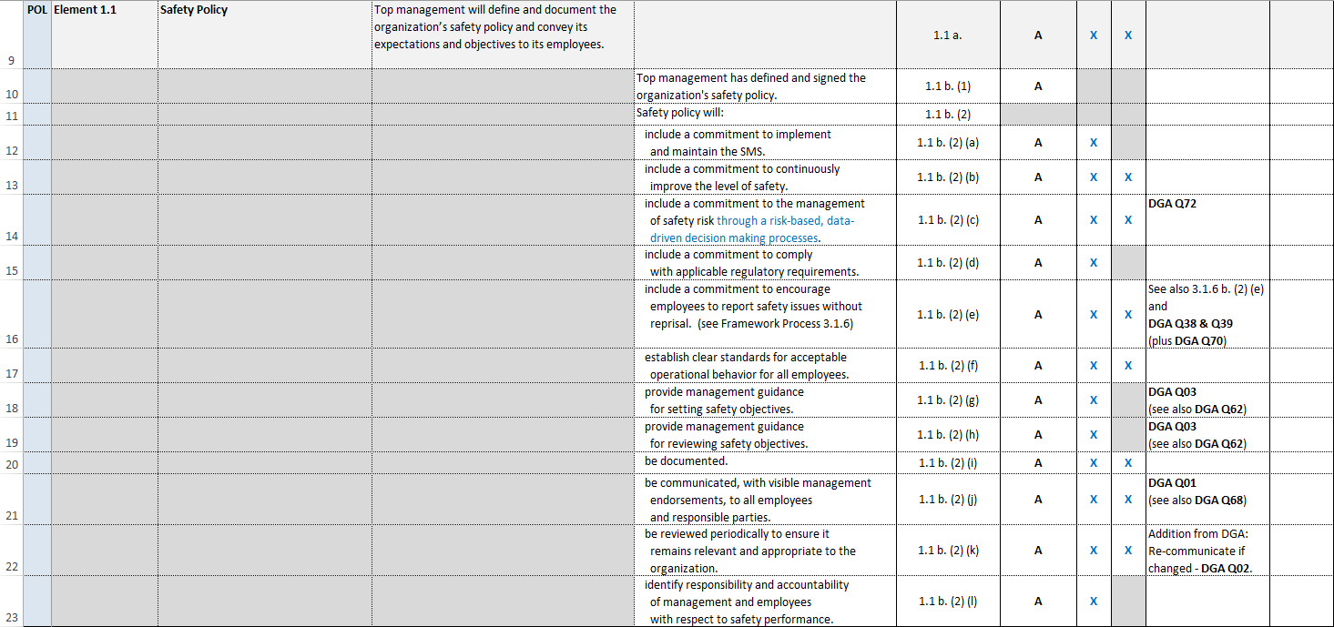
Folding SMS into Military Aerospace Programs
Element 3 – Develop the Model “Implementation Checklist”
 |  |  |  |  | Rev 3 / 1 Jun 10 |  | Flowdown
Section | Framework Component / Element / Process # |  | Performance Objective | Design Expectations | SMS Framework Reference | Core Level of Applicability | Level B | Level C | Applicability to DGA Questions | Notes
286 total lines
085 “blank” lines (81) and moved items (4)
201 actionable items

Slide 18
Folding SMS into Military Aerospace Programs
Element 3 – Develop the Model “Implementation Checklist”
 |  |  |  |  | Rev 3 / 1 Jun 10 |  | Flowdown
Section | Framework Component / Element / Process # |  | Performance Objective | Design Expectations | SMS Framework Reference | Core Level of Applicability | Level B | Level C | Applicability to DGA Questions | Notes

Slide 19
Folding SMS into Military Aerospace Programs
Element 3 – Develop the Model “Implementation Checklist”
 |  |  |  |  | Rev 3 / 1 Jun 10 |  | Flowdown
Section | Framework Component / Element / Process # |  | Performance Objective | Design Expectations | SMS Framework Reference | Core Level of Applicability | Level B | Level C | Applicability to DGA Questions | Notes
A little Air Safety Investigation motivation . . .

Slide 20
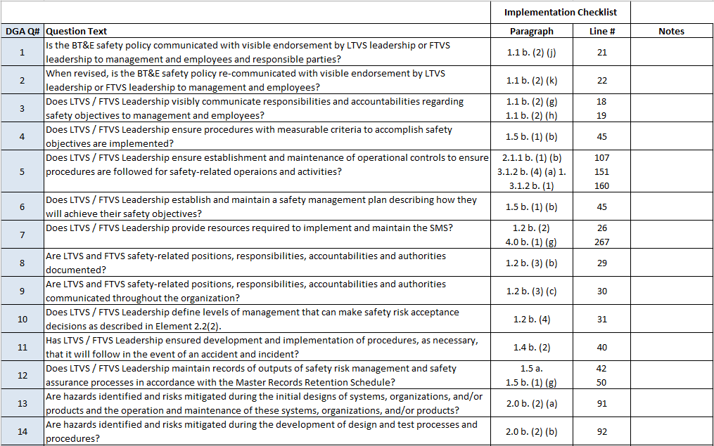
Folding SMS into Military Aerospace Programs
Element 3 – Develop the Model “Implementation Checklist”
Cross-references
  DGA

Slide 21
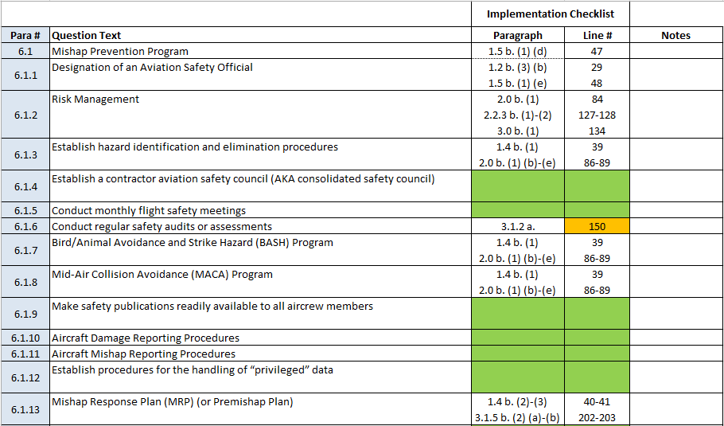
Folding SMS into Military Aerospace Programs
Element 3 – Develop the Model “Implementation Checklist”
Cross-references
  DCMA 8210.1

Slide 22
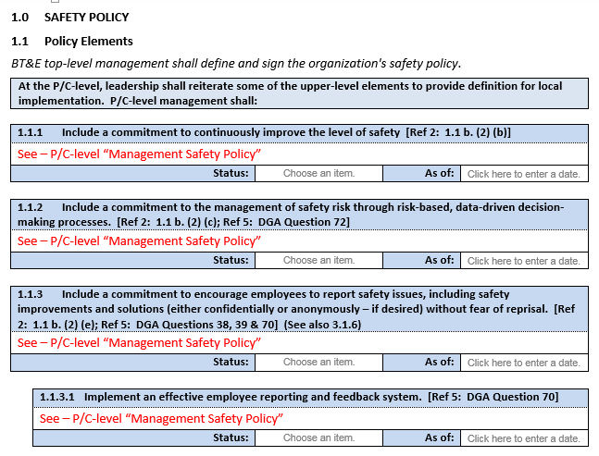
Folding SMS into Military Aerospace Programs
Element 3 – Develop the Model “Implementation Tool” (“Workbook”)

Slide 23
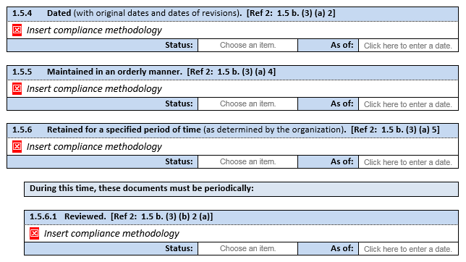
Folding SMS into Military Aerospace Programs
Element 3 – Develop the Model “Implementation Tool” (“Workbook”)
Choose an item.
Demonstrated
Implemented
Documented
Planned
Choose an item.
Demonstrated
Implemented
Documented
Planned
Choose an item.
Demonstrated
Implemented
Documented
Planned
Choose an item.
Demonstrated
Implemented
Documented
Planned
Choose an item.
Demonstrated
Implemented
Documented
Planned
Choose an item.
Demonstrated
Implemented
Documented
Planned
Workbook provides implementation tracking for SMS for the organization.
Once completed by the user, the workbook feeds the development of the corresponding SMS supplement (template).

Slide 24
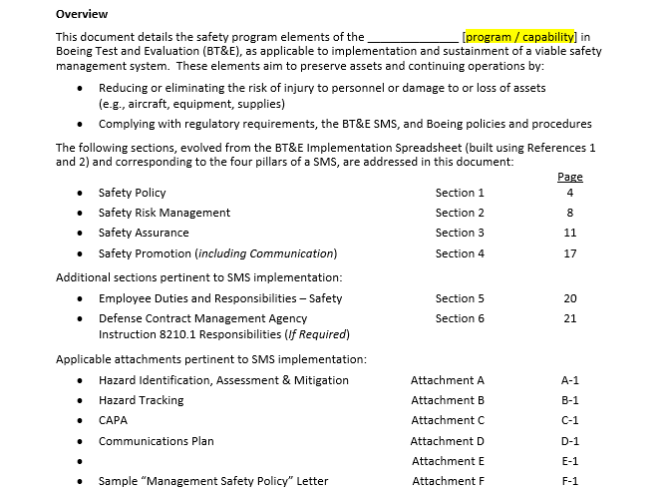
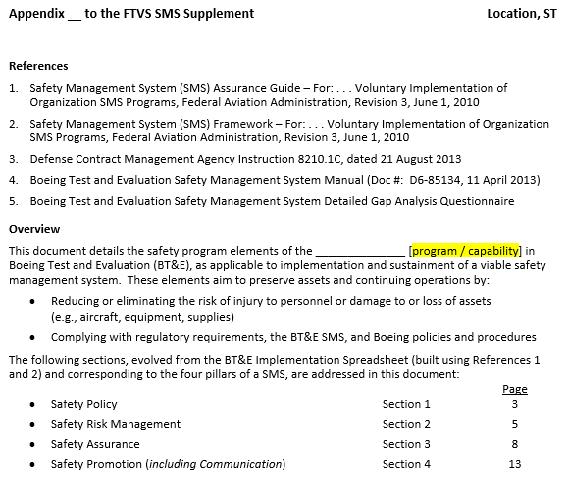
Folding SMS into Military Aerospace Programs
Element 4 – Transition Model to Template

